Slide 1
Project 1B
CS111 Discussion 1D

Slide 2
Some Logistics
Project 0 will be graded and marks will be posted on CCLE by next Monday
My office hours will be on Wednesday between 10:00 AM and 12:00 PM in Eng IV. 67-112
Test your code on lnxsrv09 to ensure that it works
Project 1A is helpful for 1B, so ensure that 1A --shell works and that you understand the procedureYour projects will be graded on lnxsrv09, test on that server

Slide 3
Problem statement
Passing input and output over a TCP socket
2) Encrypting communication
Client
Project 1A as a starting point. Terminal operating in no echo, non-canonical mode
Supports a --port=port# switch (remove --shell)
TCP socket connects client and server
Sends information from keyboard to socket (also echo) and from socket to display
--log=filename option, which maintains a record of data sent over the socket
Include encryption/decryption
Server
Project 1A --shell option as a starting point.
Listen on socket, accept connection on --port=port#
Fork after data is obtained, exec shell in child process, pass data to it via pipes
Process interrupts ^C and ^D on server
Enable encryption/decryption
Initiate shutdowns from server side

Slide 4
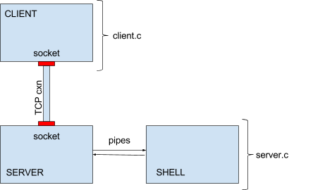
Problem statement
Design Schematic

Slide 5
Headers

Slide 6
socket(7)
Manual sections

Slide 7
socket(7)

Slide 8
socket(7)
Normally only a single protocol exists to support a particular socket type within a given protocol family, in which case protocol can be specified as 0
SOCK_STREAM only implements TCP, so this entry can be set to 0 (else set IPPROTO_TCP)
Returns fd for end point of socket (lowest unused fd)

Slide 9
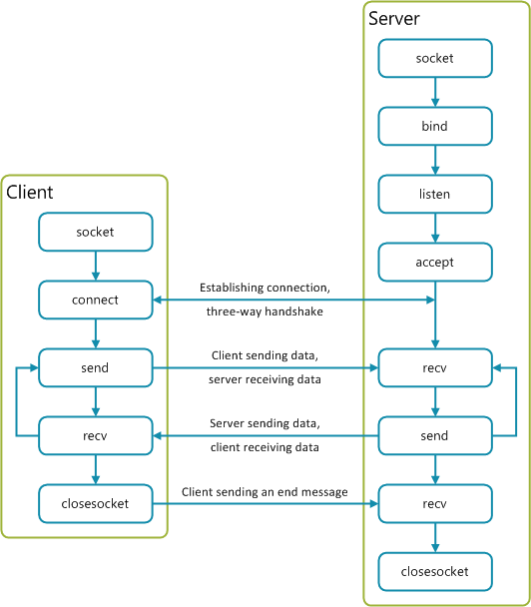
TCP socket client-server communication

Slide 10
connect(2)
Connects socket referred to by sock fd to the socket specified by the sockaddr

Slide 11
gethostbyname(3)
returns a structure of type hostent for the given host name. name is either a hostname or an IPv4 address in standard dot notation

Slide 12
struct sockaddr_in
Use bzero to set the struct to zero
And bcopy to copy the relevant fields from the hostent struct (h_addr which is the first element of h_addr_list) to the sockaddr_in struct (.sin_addr.s_addr)
Assign htons(port) to .sin_port

Slide 13
bind(2)
Server side – create socket (Set .sin_addr.s_addr = INADDR_ANY, other parameters will be similar to previously)
Then bind it
Here sockfd will be the fd of the server side socket created. bind() binds the socket referred to by sockfd to the sockaddr
Ex. aServer.sin_family = AF_INET;
aServer.sin_addr.s_addr = INADDR_ANY;
aServer.sin_port = htons(5150);
bind( ListenSocket, (sockaddr*) &aServer, sizeof(aServer) );

Slide 14
listen(2)
listen() marks the socket referred to by sockfd as a passive socket, that is, as a socket that will be used to accept incoming connection requests using accept(2).
The listen system call allows the process to listen on the socket for connections. The first argument is the socket file descriptor, and the second is the size of the backlog queue, i.e., the number of connections that can be waiting while the process is handling a particular connection. This should be set to 5, the maximum size permitted by most systems.

Slide 15
accept(2)
accept() extracts the first connection request on the queue of pending connections for the listening socket, sockfd, creates a new connected socket, and returns a new file descriptor referring to that socket.
All communication on this connection should be done using the new file descriptor.
The second argument is a reference pointer to the address of the client on the other end of the connection, and the third argument is the size of this structure.

Slide 16
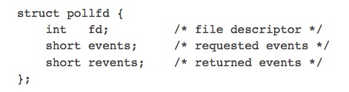
poll(2)
Manual Sections
Goal: Wait for some event on a file descriptor (for I/O)
Success: # of fd with monitored events // Error: -1
# of items in *fds
Maximum time that poll() blocks (ms)
Notes:
The field events is an input parameter, a bit mask specifying the events the application is interested in for the file descriptor fd. If this field is specified as zero, then all events are ignored for fd and revents returns zero.
The field revents is an output parameter, filled by the kernel with the events that actually occurred. The bits returned in revents can include any of those specified in events, or one of the values POLLERR, POLLHUP, or POLLNVAL. (These three bits are meaningless in the events field, and will be set in the revents field whenever the corresponding condition is true.)
The caller should specify the number of items in the fds array in nfds.
The field fd contains a file descriptor for an open file. If this field is negative, then the corresponding events field is ignored and the revents field returns zero. (This provides an easy way of ignoring a file descriptor for a single poll() call: simply negate the fd field.)
The bits that may be set/returned in events and revents are defined in <poll.h>:
Specifying a timeout of zero causes poll() to return immediately, even if no file descriptors are ready.
The timeout argument specifies the minimum number of milliseconds that poll() will block.
If none of the events requested (and no error) has occurred for any of the file descriptors, then poll() blocks until one of the events occurs.
WHAT IS INT RETURNED ()
HOW IS ERRNO SET?
WHY NOT USE READ ? ALLOW TIMEOUT

Slide 17
poll(2)

Slide 18
mcrypt(3)
Design Schematic
First function to call, This function associates the algorithm and the mode specified. Algorithm directory and mode directory can be NULL as they will be in the default location. Returns MCRYPT_FAILED on failure on encryption descriptor on success
Suggested Implementation
twofish: Twofish was designed by Bruce Schneier, Doug Whiting, John Kelsey, Chris Hall, David Wagner for Counterpane systems. Intended to be highly secure and highly flexible. It uses a 128bit block size and 128,192,256 bit key size.
cfb: The Cipher-Feedback Mode (in 8bit). This is a self-synchronizing stream cipher implemented from a block cipher. This is the best mode to use for encrypting strings or streams. This mode requires an IV.
Ex. td = mcrypt_module_open("twofish", NULL, "cfb", NULL);

Slide 19
mcrypt(3)
Takes encryption descriptor as input, and returns length of IV required. Allocate required memory with malloc and then generate a random sequence
Read key, store it in a buffer. td is the encryption descriptor.
This function initializes all buffers for the specified thread. The same IV must be used for encryption/decryption.
After calling this function you can use the descriptor for encryption or decryption (not both). Returns a negative value on error.

Slide 20
mcrypt(3)
This is the main encryption function. td is the encryption descriptor
Plaintext is the text to encrypt and len should be the length (in bytes) of the plaintext.
Repeat the same procedure (with a different encryption descriptor for the input stream but use mdecrypt_generic at the end
At termination before exit, run the following for both encryption and decryption

Slide 21
Overall Workflow – client side (example)
int main( int argc, char **argv )
Get options and set terminal modes
Read keyfile in – store in buffer
Attempt server connection
Initialize input/output encryption
Create socket
Poll for keyboard input and server output
Read/process input and echo
Encrypt and send to server
Enable logging and error and exit handling throughout
Read/process server output
Decrypt and write to display

Slide 22
Overall Workflow – server side (example)
int main( int argc, char **argv )
Get options and set terminal modes
Read keyfile in – store in buffer
Listen and accept the connection
Create socket and bind it
Initialize input/output encryption
Create pipes, fork and exec shell in child
Read instruction from client, decrypt and process to identify interrupts
Poll for input from client and output from shell
Enable logging and error and exit handling throughout
Read output from shell, encrypt and send to client
Send instructions to shell

Slide 23
Additional Information
Various socket programming tutorials online
Ex - https://www.tutorialspoint.com/unix_sockets/socket_quick_guide.htm
You may need to install the libmcrypt-dev package to get the encryption library and its documentation
Remember to cite all your references in the README file

